Slide 1
F5 Declarative Configuration
Speaker: Jim Arruda

Slide 2
Infomercial

Slide 3

Introducing the AS3!
AS3

Slide 4
Agenda
My Story
What is the AS3?
AS3 Components
AS3 Notes and Tips
Pushing the declaration to the F5 (Demo time!)
Fitting it into a pipeline (Even more demo!)
Sum it up and Q/A (No demo ☹)

Slide 5

My Story
@JimRockArruda – Twitter
https://github.com/rockarruda/F5SummitSession

Slide 6

What is the AS3?
A javascript iControl LX plug-in which exposes declarative Rest API
For creating application based objects (VIPs, Pools, Pool Members, Certs, etc.) declaratively
Abstracts away the minute details of the Application objects
Supports multi-tenancy (Partitions)
Driven by JSON

Slide 7
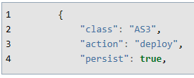
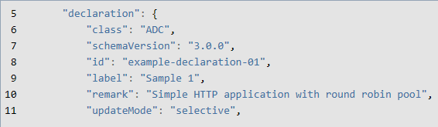
AS3 Components
AS3 Class
ADC Class

Slide 8
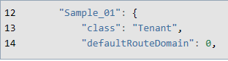
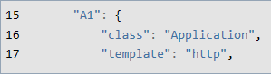
AS3 Components
Tenant Class
Application Class

Slide 9
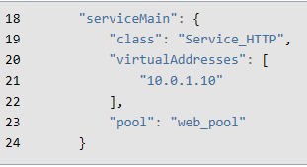
AS3 Components
Service Class

Slide 10
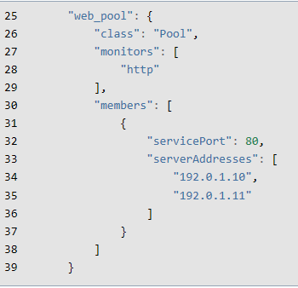
AS3 Components
Pool Class

Slide 11
AS3 Components
Full reference to the AS3 Schema can be found here:
https://clouddocs.f5.com/products/extensions/f5-appsvcs-extension/latest/refguide/schema-reference.html#schema-reference

Slide 12
AS3 Notes and Tips
AS3 becomes the source of truth
AS3 can not write to the “common” partition directly, but can use objects in that partition
Account used for config needs Administrator role
Disable the “Expect: 100 Continue” feature for automation pipeline
[System.Net.ServicePointManager]::Expect100Continue = $false
Requires minimum version of 12.1.x of BIG-IP firmware
Validation tool for VS Code!!

Slide 13

Pipeline Overview
PR Build with Pester Tests
CI Build pushes package
to Ocotopus
Octopus does variable magic
and Deploys Config to F5
AS3 Consumes JSON declaration
and configures appliance

Slide 15
In Summary
AS3 becomes the authority once you start using it
Can be used also with BIG-IQ and Ansible
Available also as a Docker Container
Multi-Tenancy provides less risk
Go out an rule the world! I am finally done!!
Questions??

Slide 16
Contact Info
Twitter - @JimRockArruda
Github - https://github.com/rockarruda/F5SummitSession

